Slide 1
Analysis of Gitlab Using Boa
Team sdmay20-43:
Diego Realpe Tobar - Data Pipeline Manager, Beloved Leader
Adrian Hamill - Data Pipeline Manager
Megan Miller - Boa Expert, R expert, Website manager
Yi-Hsien Tan - Boa Expert, Website Manager
Benjamin Carland - Boa Expert
Client/Advisor - Simanta Mitra
Website - http://sdmay20-43.sd.ece.iastate.edu/

Slide 2
Part I: Project Plan

Slide 3
Project Overview
Code Analyzer
Integrate Boa with GitLab
Analyze GitLab projects using Boa
Generate reports using R with data pulled from GitLab projects

Slide 4
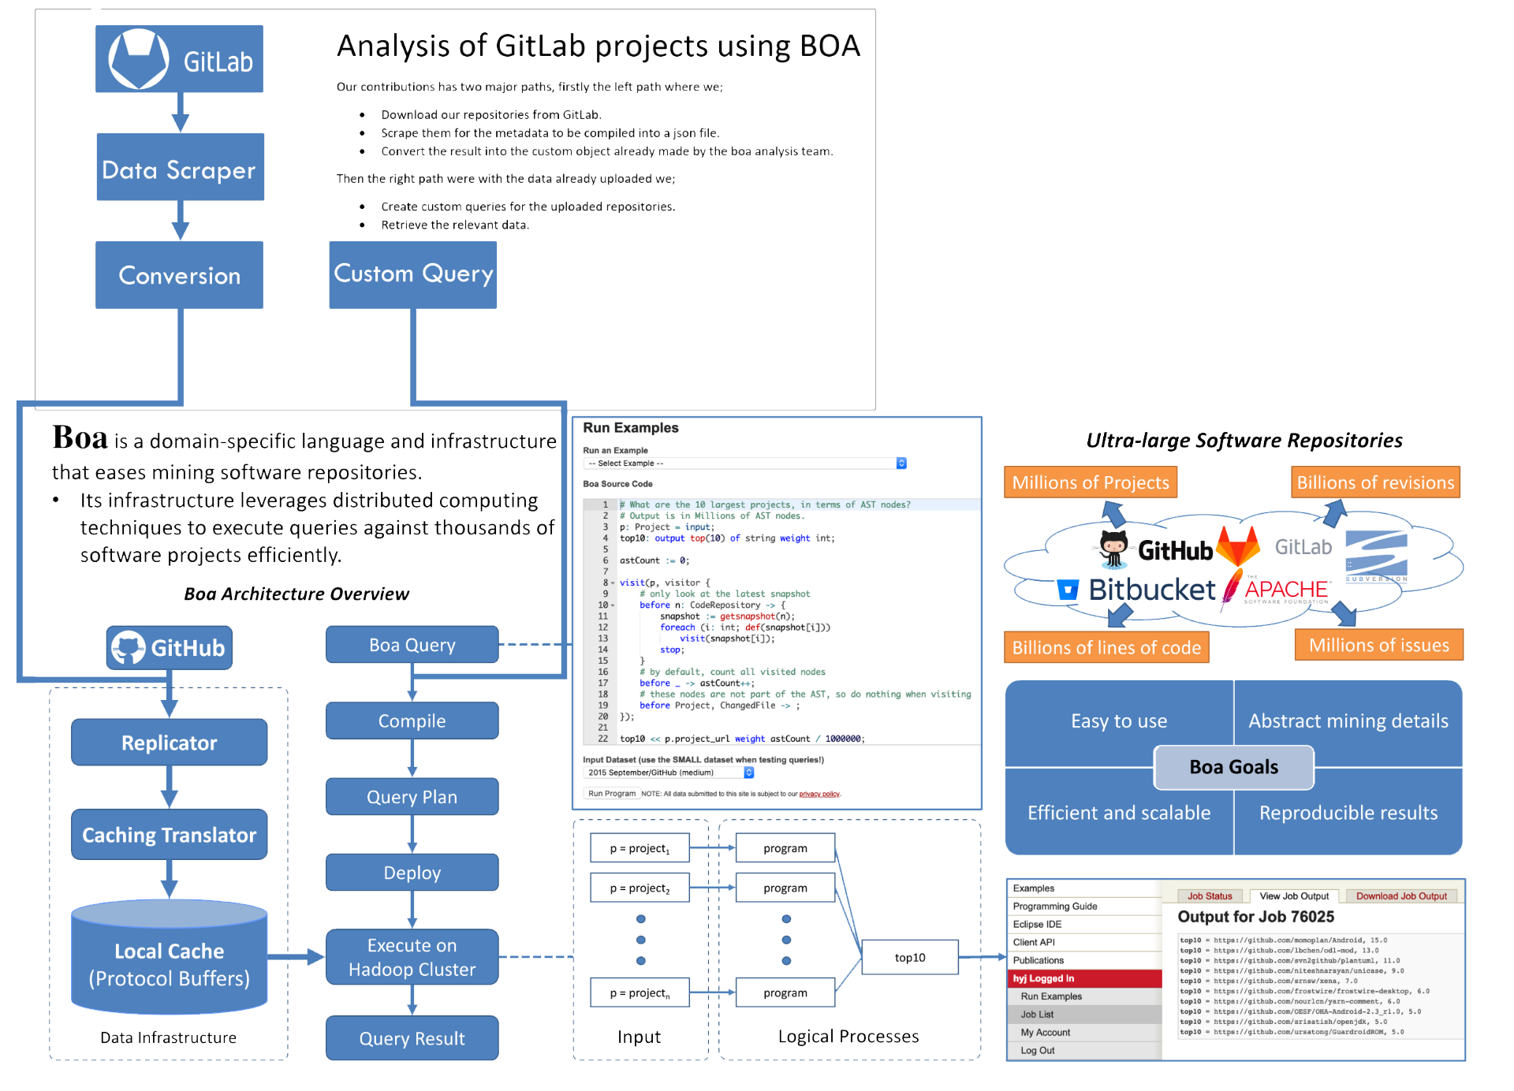
Conceptual Sketch

Slide 5
Functional Requirements
Automation - After configuration setup, the solution processes and completes with a single click from the user.
Repository Analysis - The solution utilizes the metadata from GitLab repositories.
Visual Output - Query results are put into graphical formats when possible.
Notes:
Hsien

Slide 6
Technical Considerations
Limitations of the Boa language
Lacks typical language types
Difficulty setting up pipeline for Private Gitlab repos
Important for Security requirement
Turned out to be impossible because of how the GitHub implementation of Boa works
Notes:
Hsien

Slide 7
Risk Mitigation
We maintained communication with client and within the group about all significant risks that we determined.
The risk that some of the queries that we decided on might not be possible.
Having experience it was easier to identify possible issues.
The risk that some compromises need to be made to implement the pipeline.
Repositories needed to be Public.
Notes:
Hsien

Slide 8
Resources and Cost Estimate
The monetary cost of the entire project was the Mac Mini running the Boa framework.
We found out later that it would be possible to run that on Linux, so now it runs on Linux OS.
Notes:
Hsien

Slide 9
Project Milestones & Schedule
Goal | Name of Deliverable | Expected Delivery | Actual Delivery
1 | Ideas for Boa Queries | Dec 1 | Dec 1
2 | Finalized List of Queries | Jan 20 | Jan 20
3 | Gather data to Query | Feb 2 | Feb 15
4 | Working prototype queries | Feb 15 | Mar 15
5 | Finished Queries * | Mar 1 | Apr 21
6 | Finished Product with R | Apr 1 | --
Notes:
Ben

Slide 10
Part II: System Design

Slide 11
Functional Decomposition
Notes:
Adrian

Slide 12
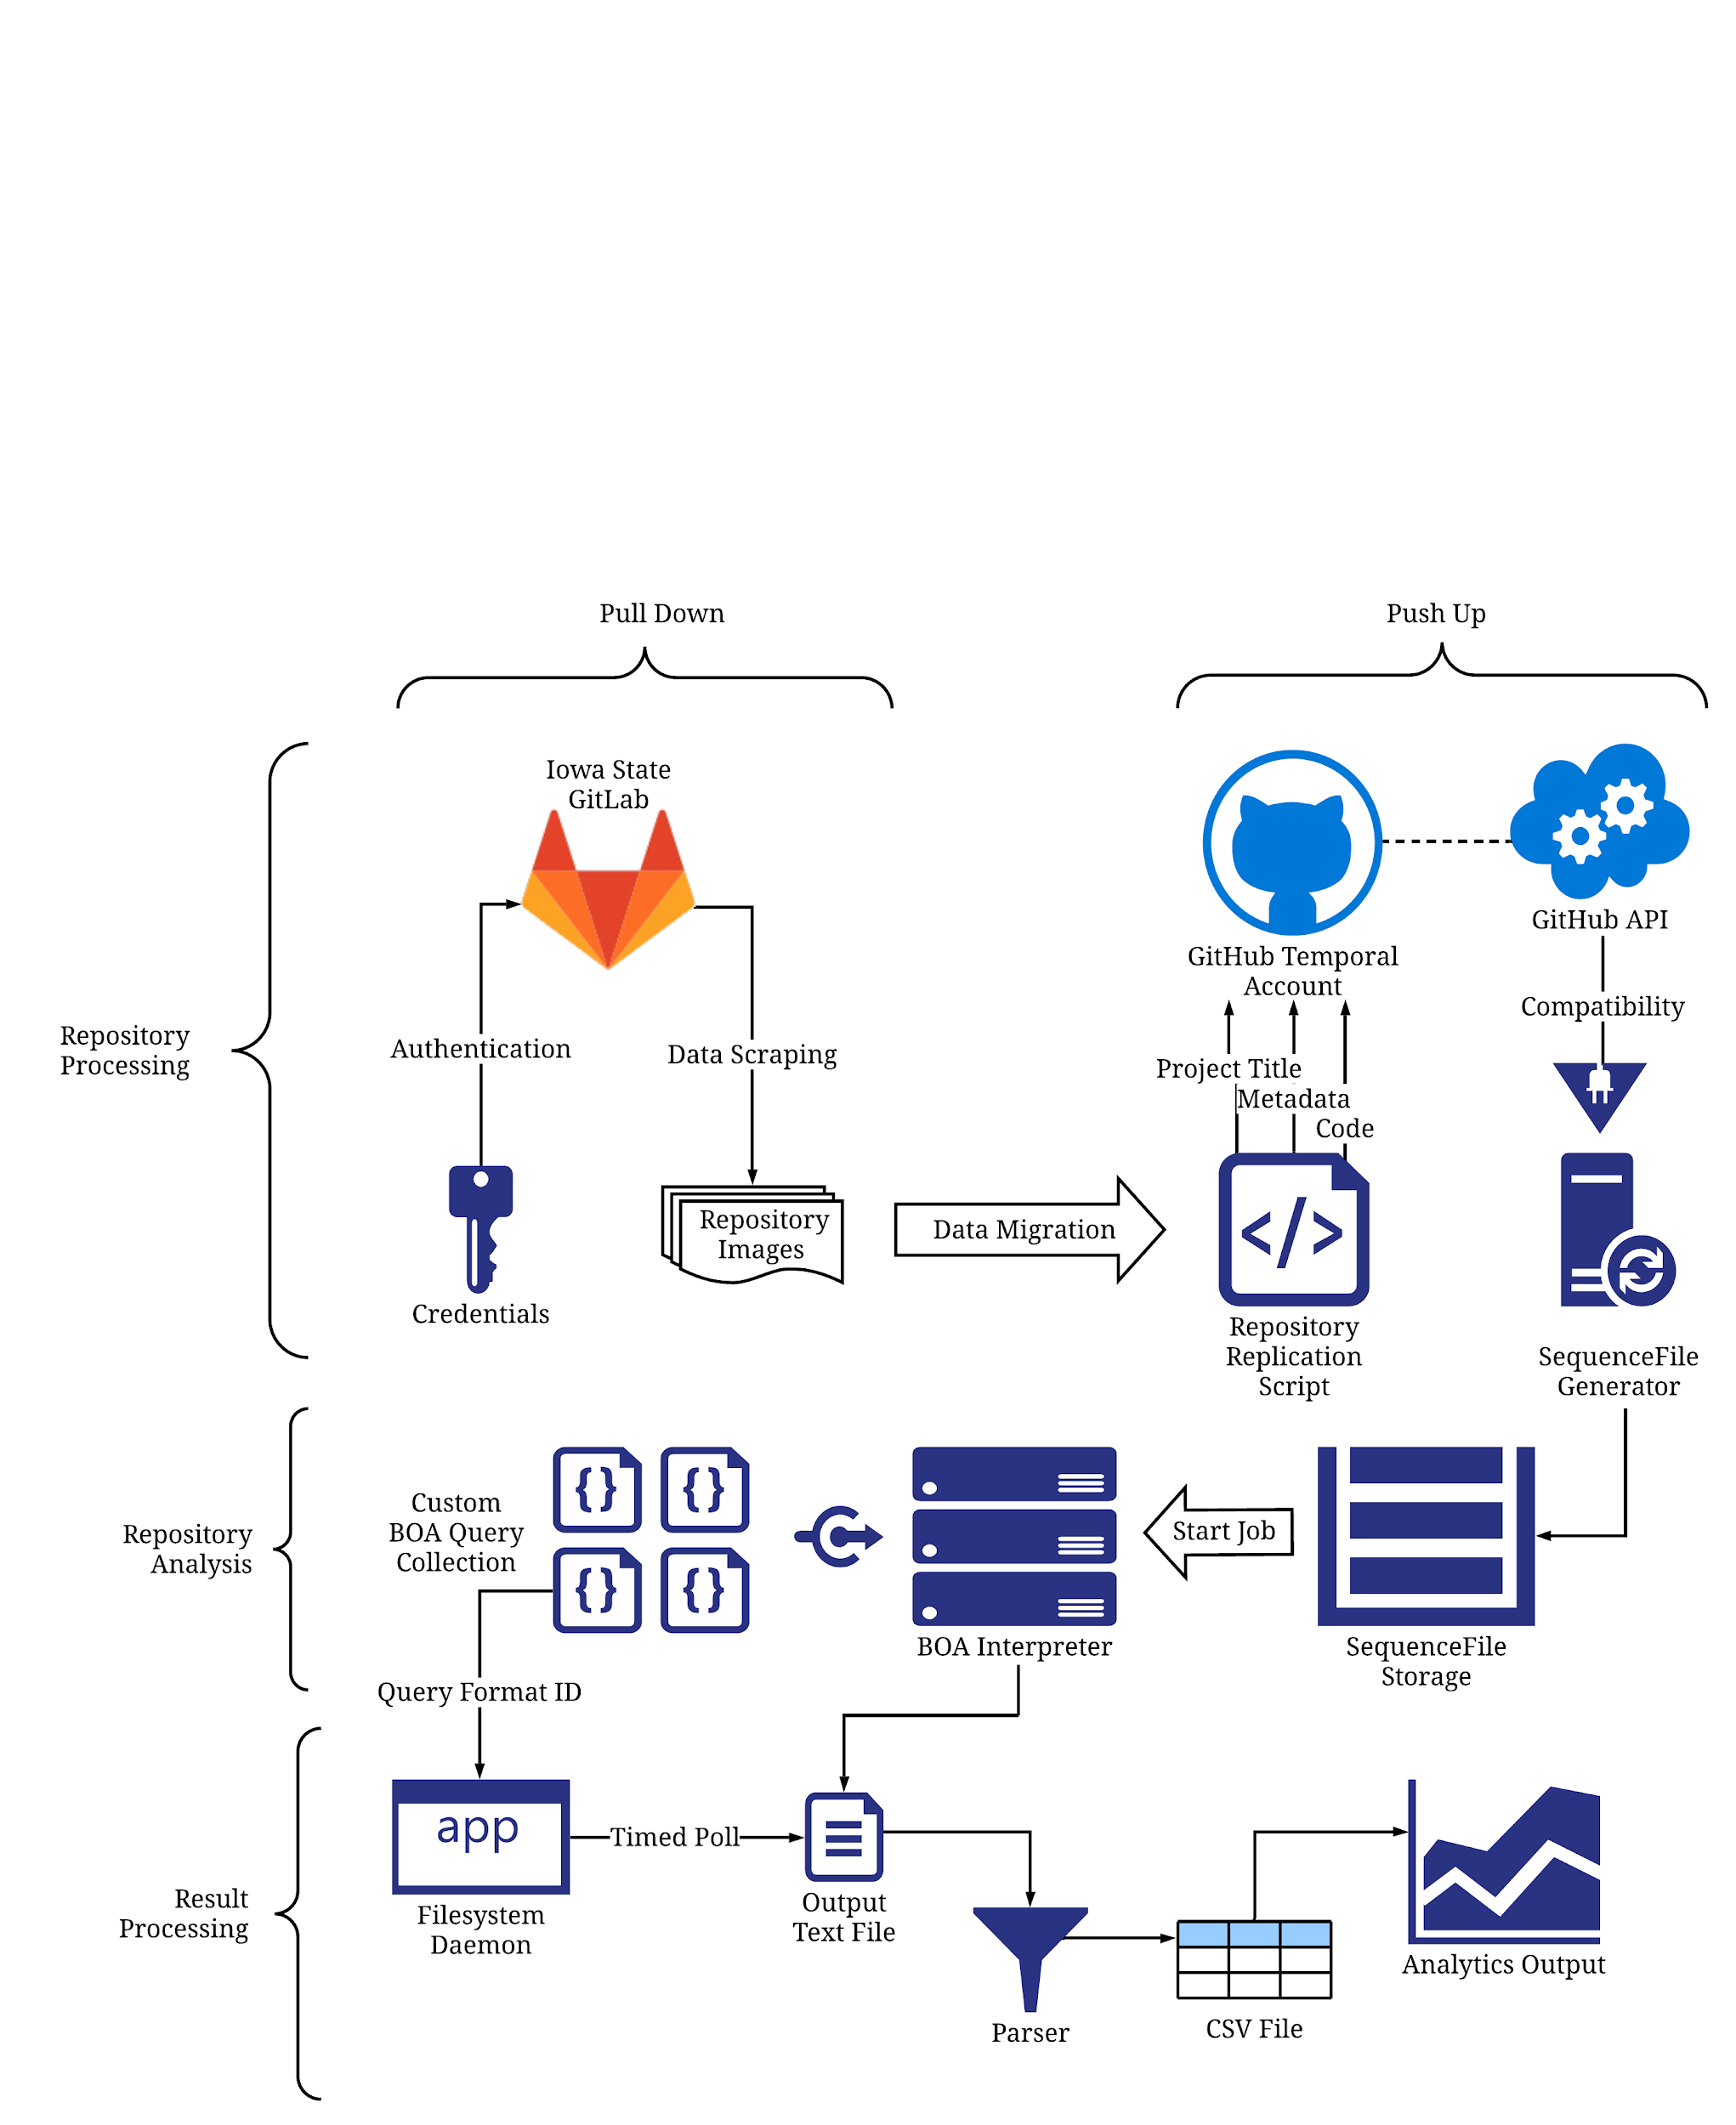
Detailed Design

Slide 13
Technologies Used
Boa Language
Bash Scripting
Git/Hub
Rscript
FSWatch
VirtualBox
Eclipse

Slide 14
Testing Implemented
Boa Queries were tested by comparing their output to an expected output for the repositories provided. There were issues in the testing and we could not deploy an automated version of Boa script testing since the language is not developed enough to do this.
On the backend, testing was done by setting up a Virtual Environment where specific functions of the code were tested separately and then ran together to test correct I/O.

Slide 15
Prototype Implementations
First prototype was to bypass GitHub altogether, we attempted to generate SequenceFiles from GitLab directly which was finally not possible
Second prototype tried to analyze micro aspects of project code with Boa + SpotBugs, this ended up not being feasible or compatible with Boa and had to be taken out.

Slide 16
Engineering Standards & Design Practices
Privacy and Security were a big focus
A lot of time was spent looking for an automated way to export GitLab projects to private
Quality
Component test assured us that the data pipeline, queries and R code were working as intended.
Notes:
Megan

Slide 17
Part III: Conclusion

Slide 18
Team Contributions
Ben: Research and development of AST pertaining queries
Megan: Aided in queries, created the R graphical scripts
Yi-Hsien: Took part in investigating and developing Boa queries
Diego: Aided in backend functionalities, developed the output parsing script, general administrative duties, managed client/teammates
Adrian: Developed the setup functionalities, leaded the “Pull Down, Push Up” solution and the execution of the Boa scripts via CLI.
Notes:
Megan

Slide 19
Future Prospects
The work done here is a significant baseline, the skeleton of this conversion tool is almost completely finished. In the future, others will be able to work out the last connecting link to these query execution and complete the range of tests available to users.
Notes:
Ben

Slide 20
Questions

